Slide 1
Covid-19
Data Visualization Track
Steve Deonarine
Ramya Subramanian
Rob Yaggi

Slide 2

Metrics We are looking to gain Insights on
Track Covid-19 data globally
Population
Tourism
Covid-19 related deaths
Average age for related deaths
Dataset
https://www.kaggle.com/datasets/mdinmore/covid-cases-mortality-with-features-by-country
Sqlite and csv files

Slide 3
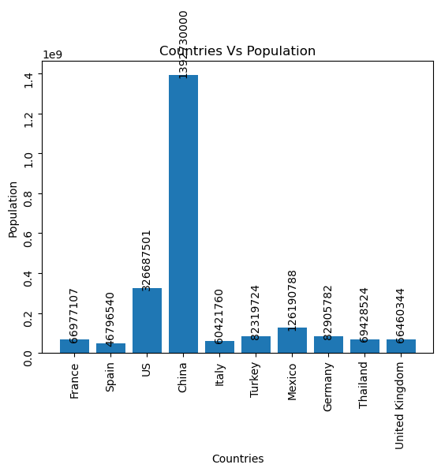
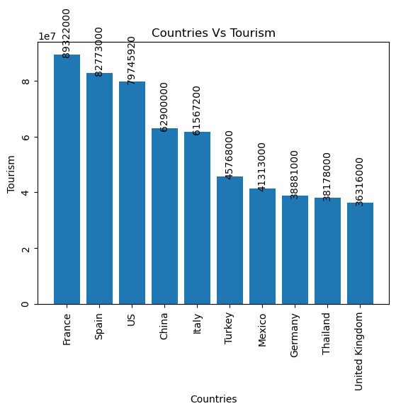
Countries with the highest Population and Tourism
Notes:
Key points to highlights:
China by far has the highest

Slide 4
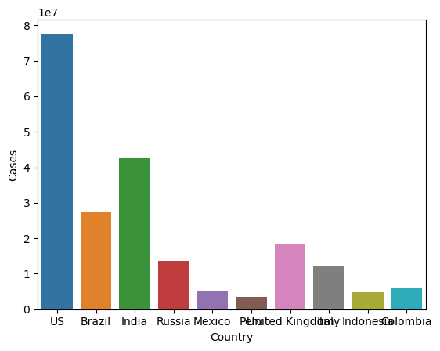
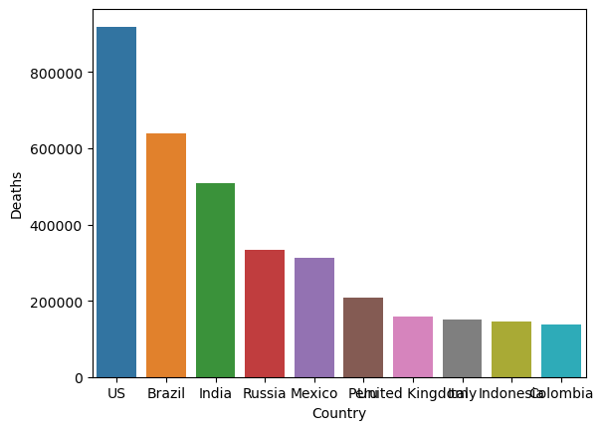
Countries with the highest Cases

Slide 5
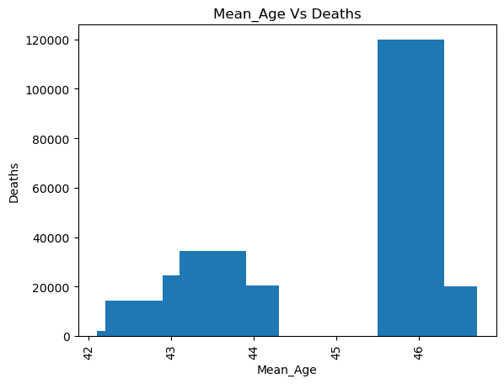
Deaths along with mean age

Slide 6
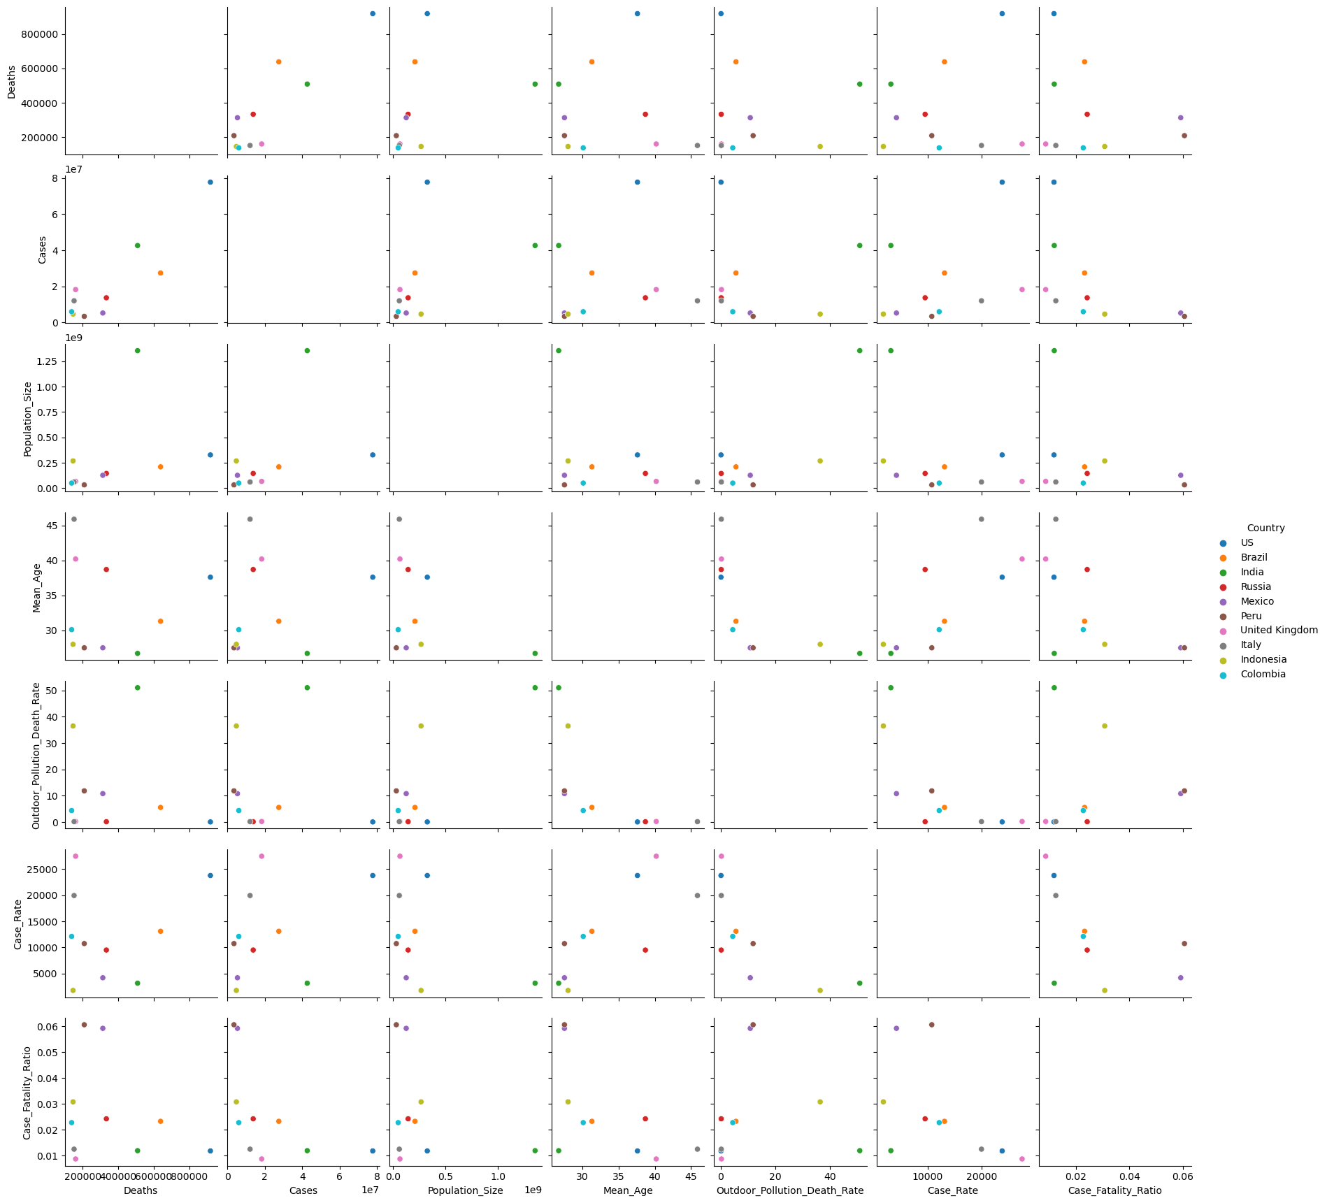
Seaborn Pairplot

Slide 7
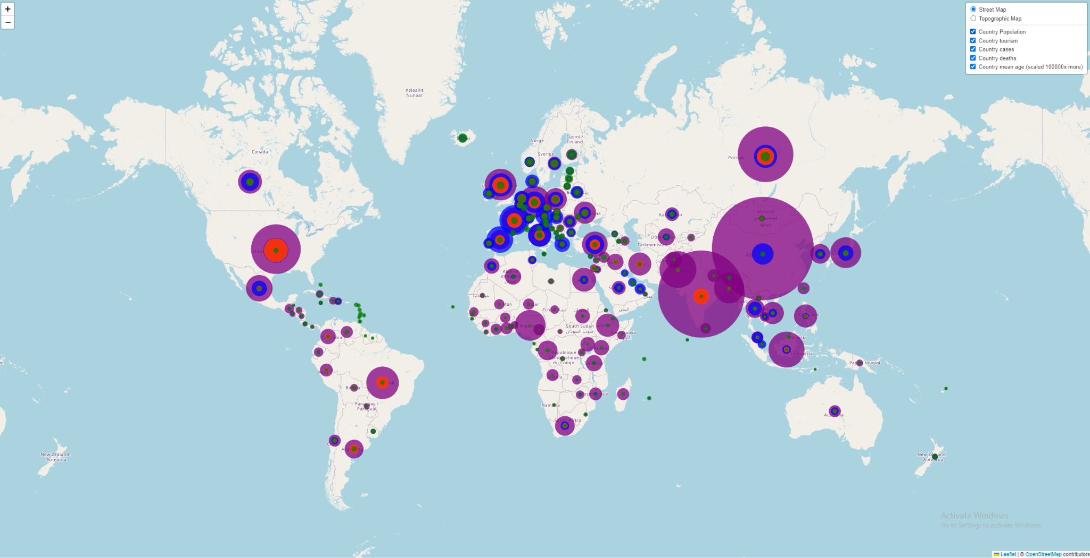
Leaflet Map

Slide 8
Takeaways:
Majority of deaths impacted individuals with a mean age of 45.9.
119,939 total deaths
France
21,075,675 cases
131,833 deaths
Spain
10,604,200 cases
95,995 deaths
China
Population 1.4 billion people
123,728 cases
4,855 deaths
US
Leading in both cases and deaths
Notes:
Spain cases ranked #11 in totals

